Slide 1
Divisibility
When a number can be divided evenly (without a remainder)

Slide 2
What is it good for?
To find out whether a number can go into a number evenly
It is used in adding, subtracting, multiplying and dividing fractions
It is used in Algebra
It is used in everyday life when deciding how many groups a number can go into.

Slide 3
What about Divisibility Rules
What is it? A quick way to test whether you can divide a number evenly.
What are the rules and how can I remember?

Slide 4
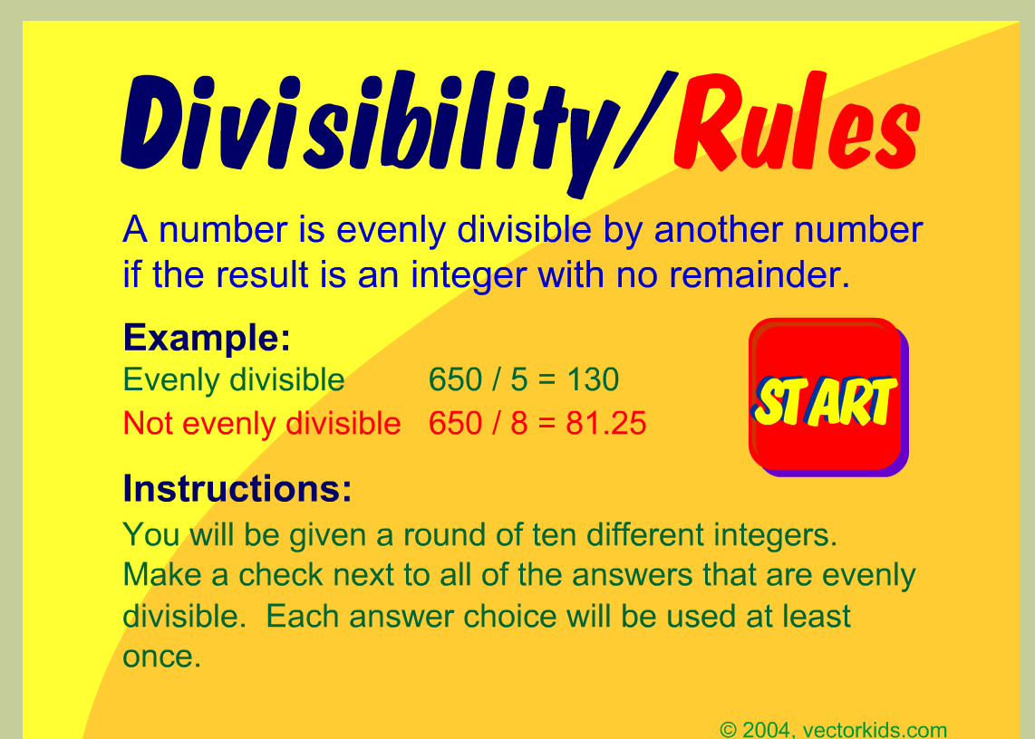

Slide 5
Website for divisibility
OA – Common Core Operations and Algebraic Thinking
Google Spang Gang and click 1st link
Bottom right OA Light blue
http://mrsspangsclass.com/ccoa.htm

